Slide 1
Covariates on Occupancy
ψ (occupancy) = ƒ (veg, patch area, patch size, matrix type)
Vegetation Structure
PC1 axis of 12 vegetation variables
Range: -3.3 – 4.4; Mean: 0.2 (± 0.2 SE)
Forest Patch Area (ha)
Range: 0.6 – 25 ha; Mean: 4.0 ha (± 0.4 SE)
Isolation (m)
Euclidean nearest-neighbor distance to forest tract > 100 ha (source pop’n) (ENN.100ha)
Range: 0 – 5120 m; Mean: 1636 m (± 150 SE)
Matrix type
Forest, Agriculture, Peri-urban, Bauxite
Notes:
Matrix type is defined as: agriculture, bauxite, peri-urban, and forest
Patch area was size of patch in hectares, and may be expressed in terms of continuous variable or as categorical variable.
small (less than 2 ha) (N = 33 patches); medium (2 ha to 5 ha) (N = 41); and large (5 ha up to 25 ha). (N = 25).

Slide 2
Covariates on Detection
p (detection) = ƒ (effort, survey date)
Effort
Number of points counts conducted per patch
Range: 1 – 13; Mean: 3.0 (± 1.5 SD)
Survey date
Date survey was conducted from February – mid June
Winter migrants: Sept/Oct – May; Summer Migrants: March-Aug/Sept
Excluded due to sampling design
Observer: 3 observers, consistent across years, sampled all paches/landscapes in rotation
Temporal order of point and patch sampling: rotated between different visits
Notes:
I plan to model local extinction as function of matrix type, forest structure, and potentially patch area.
Model local colonization as function of matrix type, and patch isolation.
Matrix type is defined as: agriculture, bauxite, peri-urban, and forest
Patch area was size of patch in hectares, and may be expressed in terms of continuous variable or as categorical variable.
small (less than 2 ha) (N = 33 patches); medium (2 ha to 5 ha) (N = 41); and large (5 ha up to 25 ha). (N = 25).
Patch isolation: I used Euclidean nearest-neighbor distance to the nearest fragment or intact forest tract greater than 100 ha.
This threshold sizes was selected to provide an estimate of the distance a bird would travel to reach a potential source population.
It will likely be categorized as a binary variable: considered to be ‘far’ if > 1 km from 100 ha remnant (N = 44) and ‘near’ if < 1 km from 100 ha forest (N = 58). The 1 km distance was based on results from translocation (Ch. 3), where an endemic resident failed to return to its territory when translocated > 1 km in distance.

Slide 3
“Simple Model”
y_{ij}
VEG
MATRIX
SIZE
ISOL
Effort
Survey
date
z_{i}
P_{ij}
ψ_{i}
Spatial structure between patches only accounted for by landscape variables
Single species
1 year
α
β
Notes:
Note – could get rid of

Slide 4





“Simple” model
$$y_{ij}\sim bern(p_{ij}z_{i})$$
Data
$${logit(p}_{ij})=α_{0}+α_{1}{(Effort)}_{i}+α_{2}{(Date)}_{j}$$
$$z_{i}\sim bern(ψ_{i})$$
Process
$${logit(ψ}_{i})=β_{0}+β_{1}{(ag)}_{i} + β_{2}{(urb)}_{i}+ β_{3}{(mine)}_{i}$$
$$+β_{4}{(veg)}_{i}+β_{5}{(size)}_{i}+β_{6}{(isol)}_{i}$$
$α_{l}\sim N(0,σ_{α}^{2})$, l = 0,…,3
Parameter
$β_{k}\sim N(0,σ_{β}^{2})$, k = 0,…,6

Slide 5
“Spatial” Model
y_{ij}
VEG
MATRIX
SIZE
ISOL
Effort
Survey date
z
α
ψ
σ²
Spatial structure (exponential decay) between patches
Single species
1 year
φ
β
Notes:
Exponential covariance function depicting relationships among patch occupancy

Slide 6





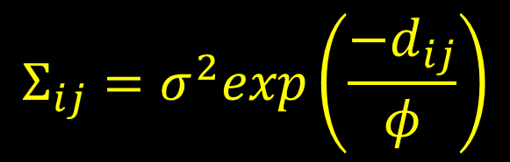
“Spatial” model
$$y_{ij}\sim bern(p_{ij}z_{i})$$
Data
$${logit(p}_{ij})=α_{0}+α_{1}{(Effort)}_{j}+α_{2}{(Date)}_{j}$$
$$z_{i}\sim bern(ψ_{i})$$
Process
$${logit(ψ}_{i})=β_{0}+β_{1}{(ag)}_{i} + β_{2}{(urb)}_{i}+ β_{3}{(mine)}_{i}$$
$$+β_{4}{(veg)}_{i}+β_{5}{(size)}_{i}+β_{6}{(isol)}_{i}+ ε_{i}$$
$α_{l}\sim N(0,σ_{α}^{2})$, l = 0,…,3
$$ε_{i}\sim N(0,Σ)$$
Parameter
$$Σ_{ij}=σ^{2}exp\left(\frac{−d_{ij}}{φ}\right)$$
$β_{k}\sim N(0,σ_{β}^{2})$, k = 0,…,6

Slide 7


Relationships within and among landscapes may affect occupancy
$$Σ_{ii′}=σ^{2}exp\left(\frac{−d_{ii′}}{φ}\right)$$
$$Σ_{ii′}$$
1 km
d_{ii’}

Slide 8

$$Σ_{ii′}=σ^{2}exp\left(\frac{−d_{ii′}}{φ}\right)$$
$$Σ_{ii′}$$
Once landscape effects are accounted for, we expect remaining spatial structure to occur at the sub-landscape scale
1 km
d_{ij}

Slide 9




$$Σ_{ii′}=σ^{2}exp\left(\frac{−d_{ii′}}{φ}\right)$$
Priors for σ² and φ:
$σ^{2}\sim IG$(r, g)
$$Σ_{ij}$$
φ = fixed = 300m
or
$$log⁡(φ)\sim N(μ_{φ},σ_{φ}^{2})$$
1 km
D_{ii’}

Slide 10
“Multi-species” Model
y_{ij}
VEG
MATRIX
SIZE
ISOL
Effort
Survey
date
z
α
ψ
μ_{β}
Spatial structure between patches
Migrant community (N = 21 species)
1 year
σ²
φ
β
σ²_{β}
Notes:
In the community hierarchal level of the model, the species-specific parameters were linked together through a common distribution (Royle & Dorazio 2008).

Slide 11



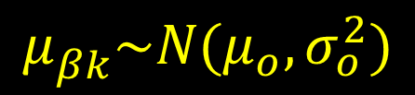

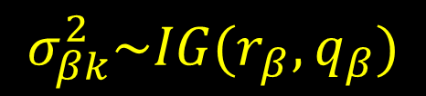



“Multispecies” model
$$y_{ijs}\sim bern(p_{ijs}z_{is})$$
Data
$${logit(p}_{ijs})=α_{0s}+α_{1s}{(Effort)}_{j}+α_{2s}{(Date)}_{j}$$
$$z_{is}\sim bern(ψ_{i})$$
Process
$${logit(ψ}_{is})=β_{0s}+β_{1s}{(ag)}_{i} + β_{2s}{(urb)}_{i}+ β_{3s}{(mine)}_{i}$$
$$+β_{4s}{(veg)}_{i}+β_{5s}{(size)}_{i}+β_{6s}{(isol)}_{i}+ ε_{is}$$
$$ε_{is}\sim N(0,Σ)$$
$α_{ls}\sim N(0,σ_{α}^{2})$, l = 0,…,3
$$Σ_{ii′}\sim σ^{2}exp\left(\frac{−d_{ii′}}{φ}\right)$$
Parameter
$β_{ks}\sim N(μ_{βk},σ_{βk}^{2})$, k = 0,…,6
$$σ_{βk}^{2}\sim IG(r_{β},q_{β})$$
$$μ_{βk}^{}\sim N(μ_{o},σ_{o}^{2})$$

Slide 12
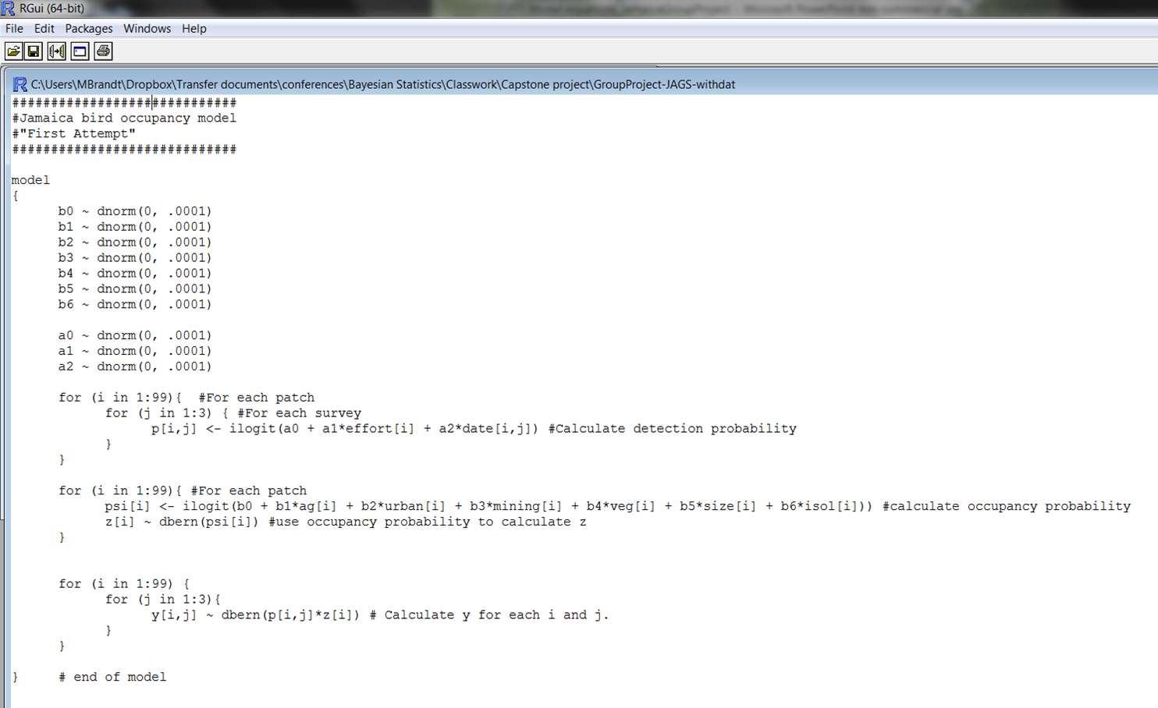
Getting “JAG-GY” with it…….

